Slide 1


State of the SharePoint PowerShell nation 2019
#SPSBE
Spencer Harbar | @harbars
SharePoint Saturday Belgium 2019

Slide 3





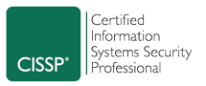
Hello!
Spencer Harbar
Enterprise Architect
Edinburgh, United Kingdom Scotland ☺
www.harbar.net
spence@harbar.net
@harbars
In recent times working mostly with IdM, Azure & Data Centre related technologies…
IdM, Azure, PaaS, .NET microservices, blockchain, PowerShell, network, data centre security and automation
....but there is no escape from SharePoint! ☺ “Just when I thought I was out… they pull me back in.”
Like most of us, I started with SharePoint, by “accident” nearly 20 years ago
“Spencer knows where the bodies are buried” – Unnamed VP @ Microsoft
Tries to avoid being sat in front of a computer
Makes photographs, climbs rocks, makes music, plays golf, drinks whisky
Works mostly with enterprise customers
Works with IdM, Azure, PowerShell and SharePoint PGs on futures and field readiness
Microsoft 365 Migrations and Adoption programmes
Co-organiser of European Collaboration Summit and European Cloud Summit

Slide 4


Slide 5
Agenda
Common approaches to PowerShell for SharePoint
Core principles of PowerShell
SharePoint and Office 365 Considerations
Introduction to re-usable Tooling
Desired State Configuration
Worked example for SharePoint
Other techniques to consider
Summary

Slide 6

Common Approaches To SharePoint PowerShell
#SPSBE
SharePoint Saturday Belgium 2019

Slide 7
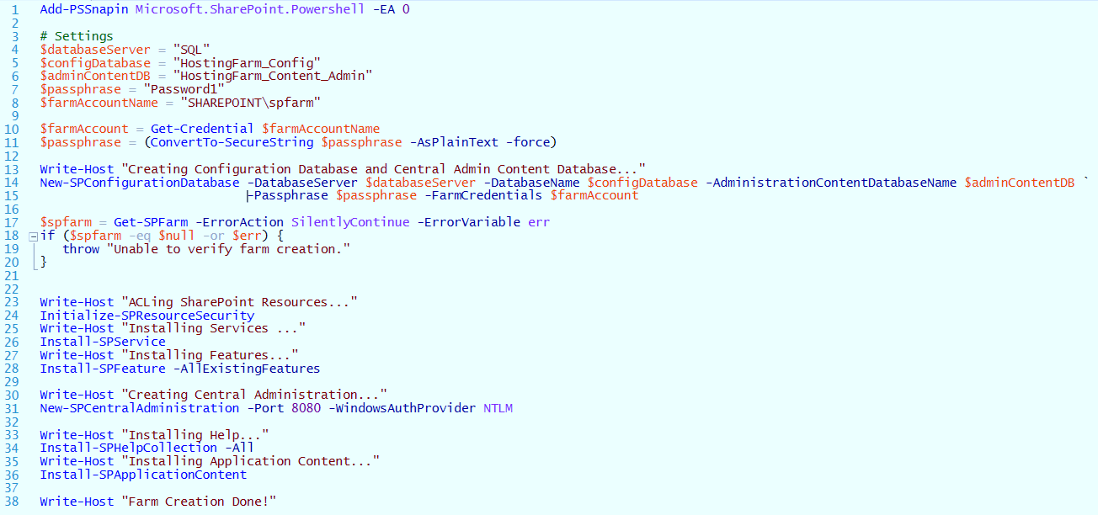
Adhoc Scripting: Typical “Snippets”

Slide 8
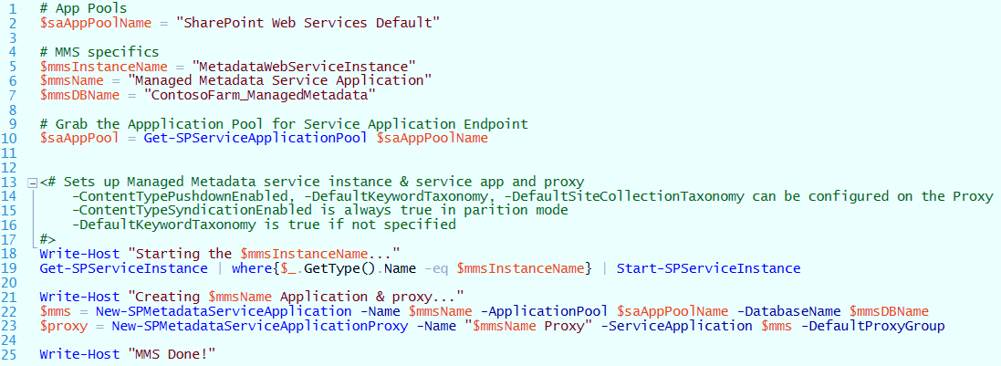
Adhoc Scripting: Typical “Snippets”

Slide 9
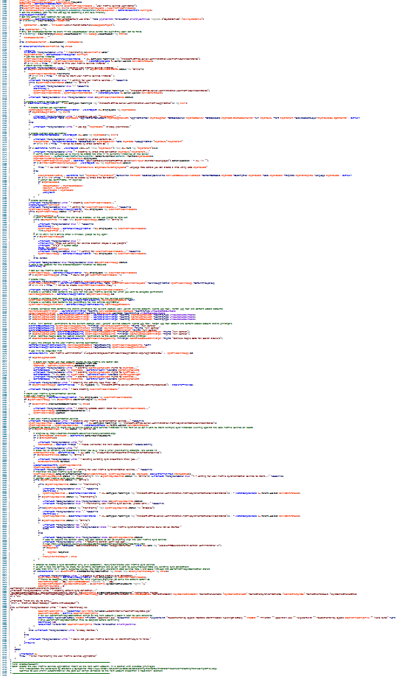
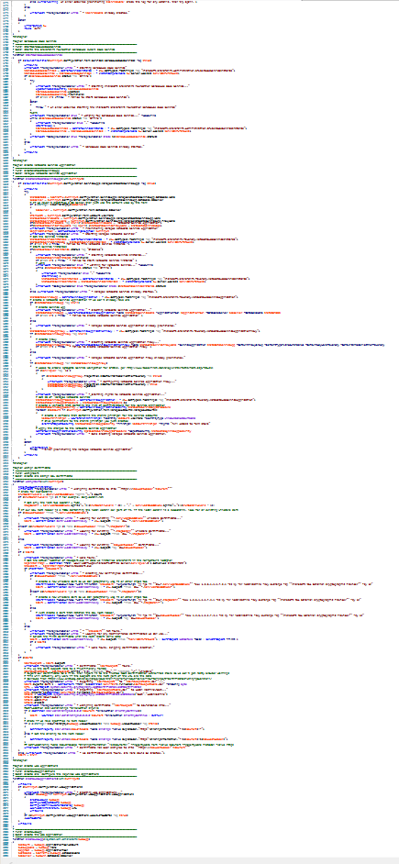
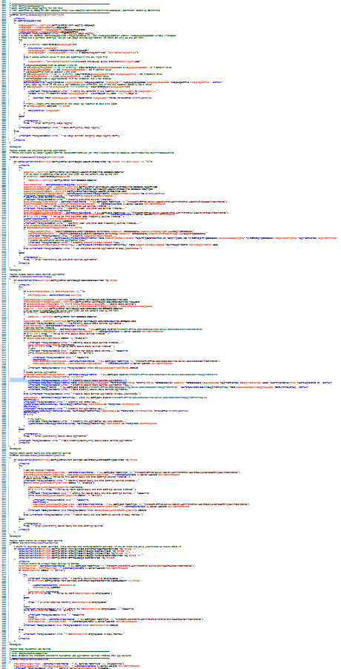
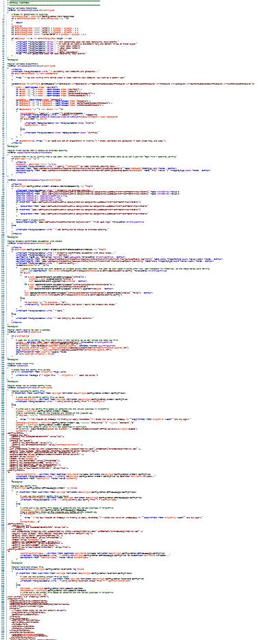
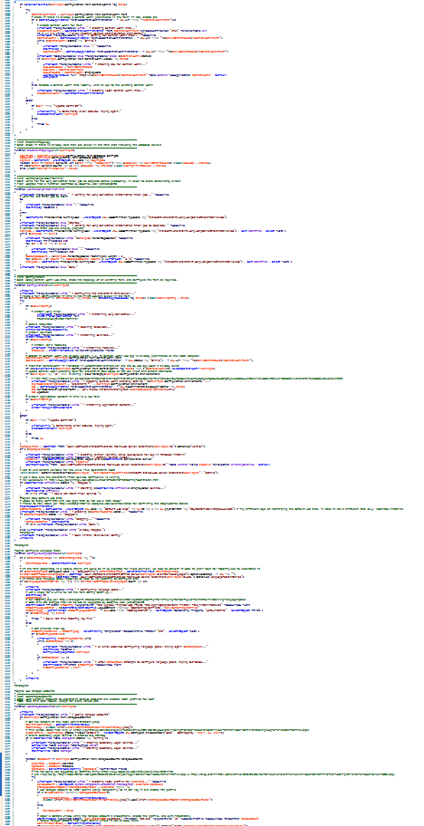
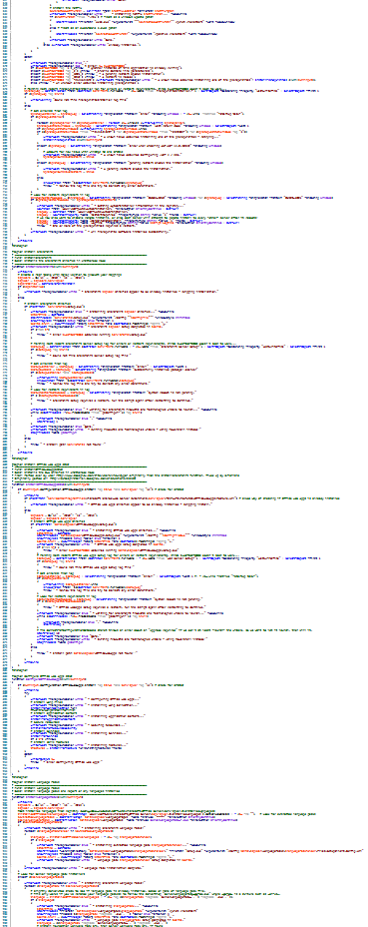
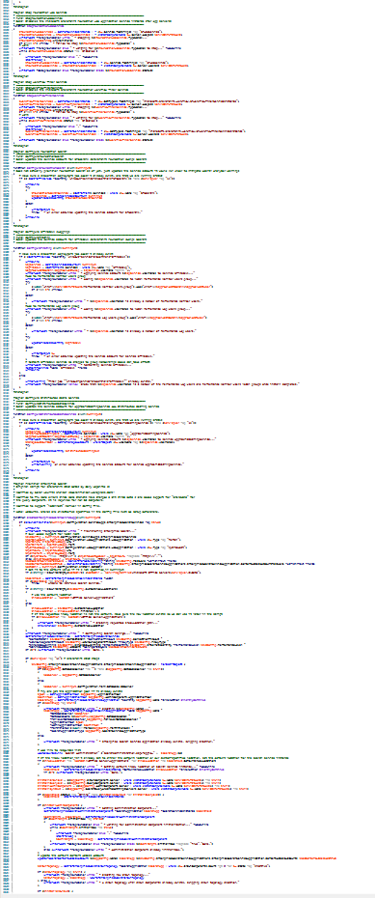
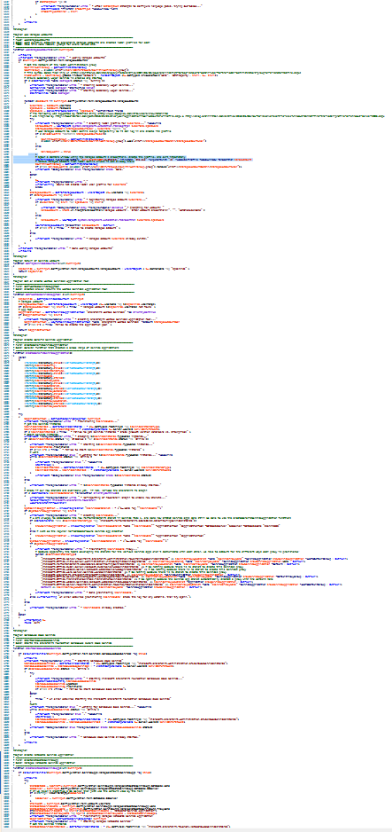
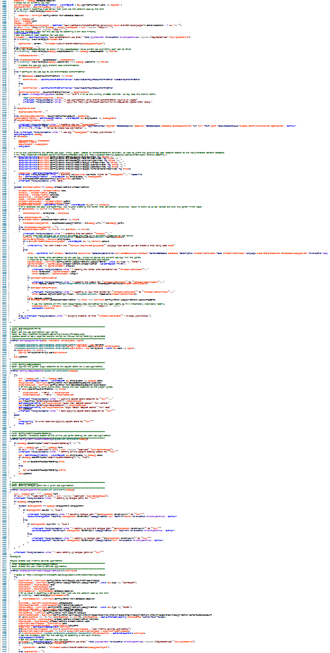
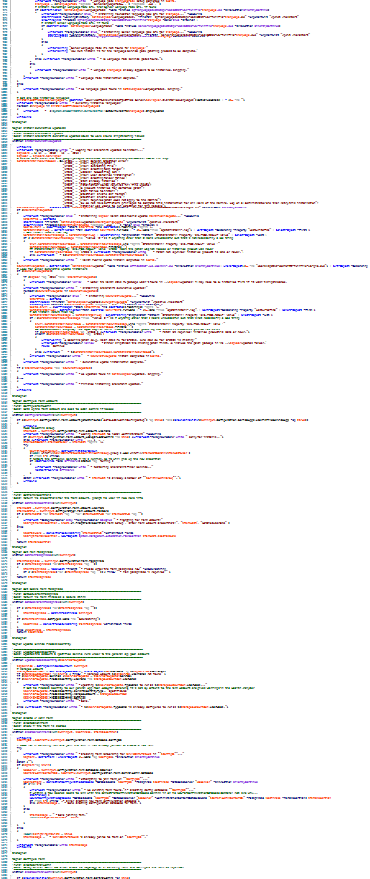
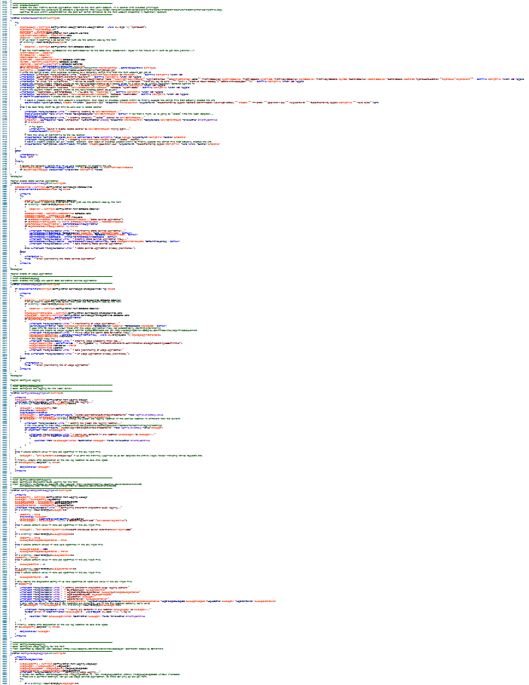
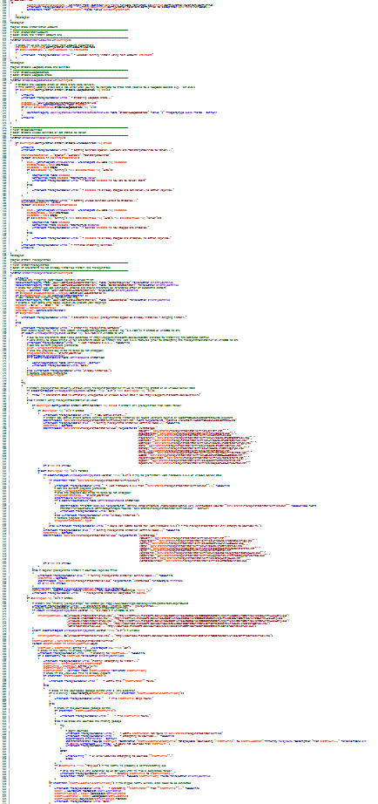
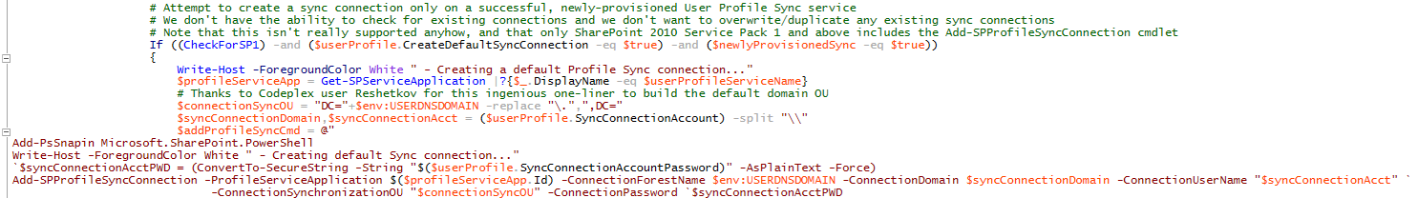
Über scripts
AutoSPInstaller
SPAuto
AutoSPDeploy
SPModule
etc
“One script to rule them all”

Slide 10
Adhoc Scripting
Automation versus Productivity
Absolutely imperative to understand what a script does!
And how it does it
The devil is always in the detail!
Not everything can be done with a cmdlet
Bugs and issues with SharePoint cmdlets and/or management APIs
SPO/Office 365 “pattern” – set credentials, connect, perform action, commit

Slide 11
Focus on Initial Deployment
Installing and configuring farm(s) is simply the beginning
Operational Service Management over the deployment lifecycle is way more important than building out a farm
Does operations have familiarity with key components?
Or are they merely executing scripts provided to them?
Do they even know how to launch the PowerShell Shell? ☺

Slide 12
Core PowerShell Principles Let’s go ALL the way back for a moment
#SPSBE
SharePoint Saturday Belgium 2019

Slide 13
PowerShell Principles
One could figure out all scenarios and implement solutions for them
However, scenarios change!
The world, especially the SharePoint world can be a messy place
Think… Type… Get
What each customer thinks/wants is different
Monad Manifesto – the Origin of Windows PowerShell https://msdnshared.blob.core.windows.net/media/MSDNBlogsFS/prod.evol.blogs.msdn.com/CommunityServer.Components.PostAttachments/00/01/91/05/67/Monad%20Manifesto%20-%20Public.doc

Slide 14
Compositional Management
For example, Add a User
Many, many variables
Each customer’s process will be different
“The whole is greater than the sum of its parts”
Aristotle
It’s not about understanding a bunch of cmdlets
But how to use them together to deliver automation solutions

Slide 15
Stateless, Idempotent Management
In order to manage billions of devices, machines, and applications…
Management APIs should be:
Discrete
Stateless
Idempotent
Handle all outcomes

Slide 16
It’s all about a “Toolbox”
Allows for fast and easy creation of solutions for operational scenarios
Different tools for different jobs
Modular, reusable
Become a tool maker rather than a “tool” ☺
Don’t be an adhoc scripter solving immediate problems
The time invested will pay off over the medium term
Allowing you to make better use of your time and skills
Allows you to learn much more
Can be used across other products
Any skills investment targeting On Premises will be valuable elsewhere

Slide 17

SharePoint Oh vey – here we go…
#SPSBE
SharePoint Saturday Belgium 2019

Slide 18

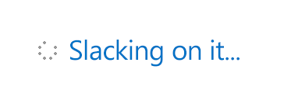
Working on it…
Originally ‘designed’ and built 2007-2009
It’s a Snap-in, not a module
No xcopy, no dynamic discovery, slow to load
Extremely weak support for multi-server (farm) operations
It’s either server or farm
Very few cmdlets validate presence of service instances
Built and tested in single server deployments
No awareness of remoting
Poor code quality and consistency
Inconsistent naming, inconsistent parameters
Incorrect handling of optional parameters and Nulls
Incorrect handling of switch parameters
Built and tested using the Farm Account
“Missing” cmdlets
Inadequate and missing help implementation

Slide 19
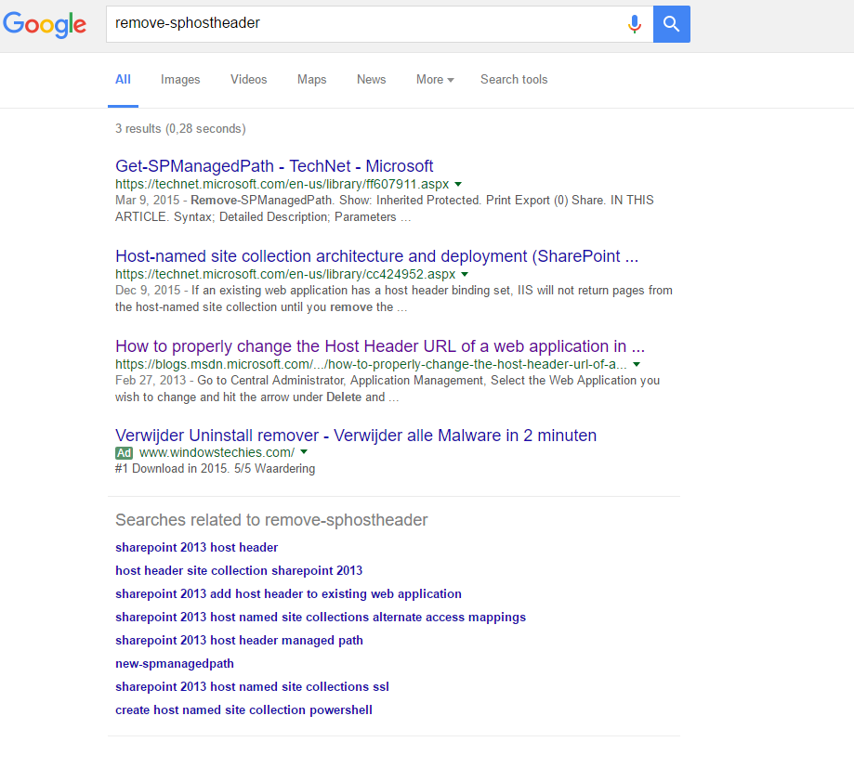
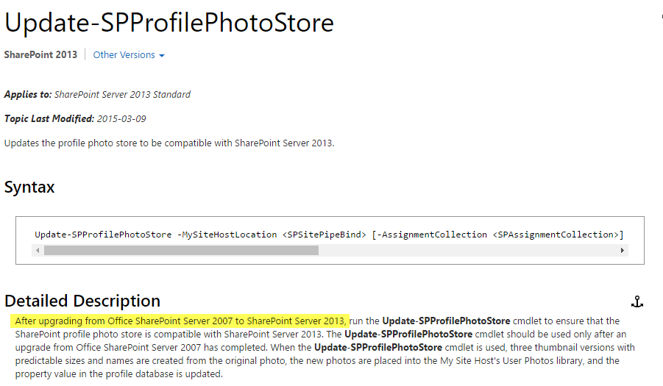
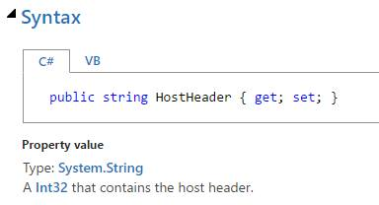
Working on it…

Slide 20
Working on it…
Missing playbook
Major bugs
Significant dependencies
Most elements are simply shims for inadequate, legacy management APIs
Most elements entirely devoid of remoting principles
All the non-SharePoint work needed when operating a SharePoint farm
AD, DNS, SQL, Network Stack, NLB, SQL Server etc
Bottom line: It’s a legacy implementation, we need to provide the “toolbox”
Lack of core platform investment means SharePoint On Premises and SharePoint Online will be significantly behind PowerShell - e.g. PowerShell 6, x-plat, etc

Slide 21
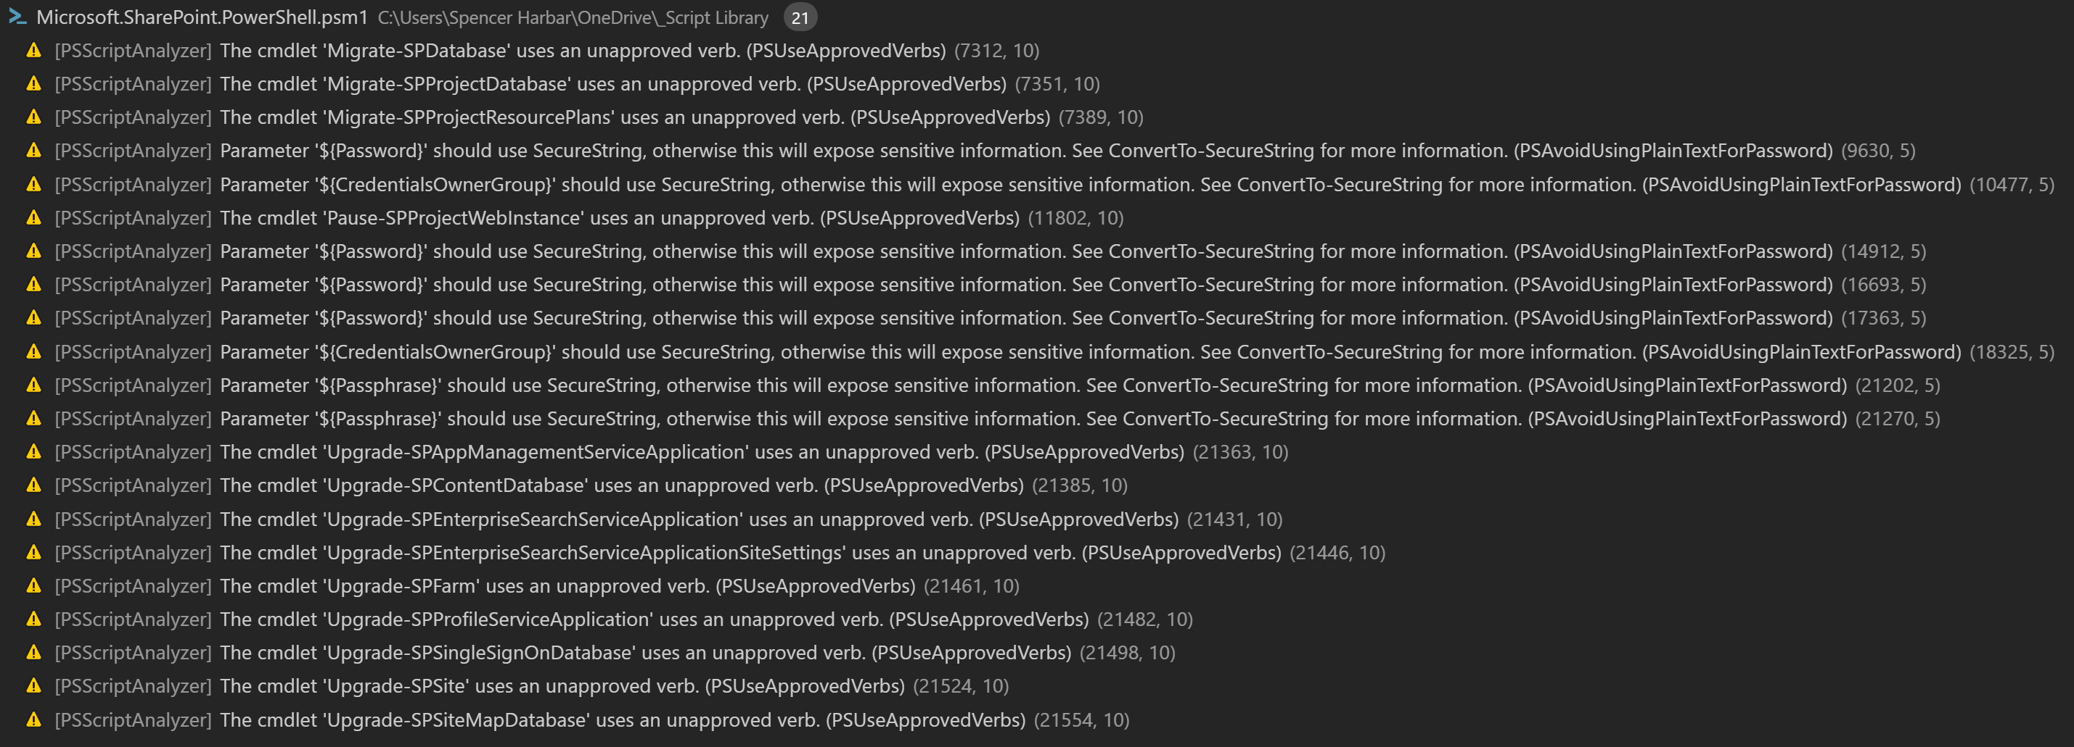
Even the basics!

Slide 22
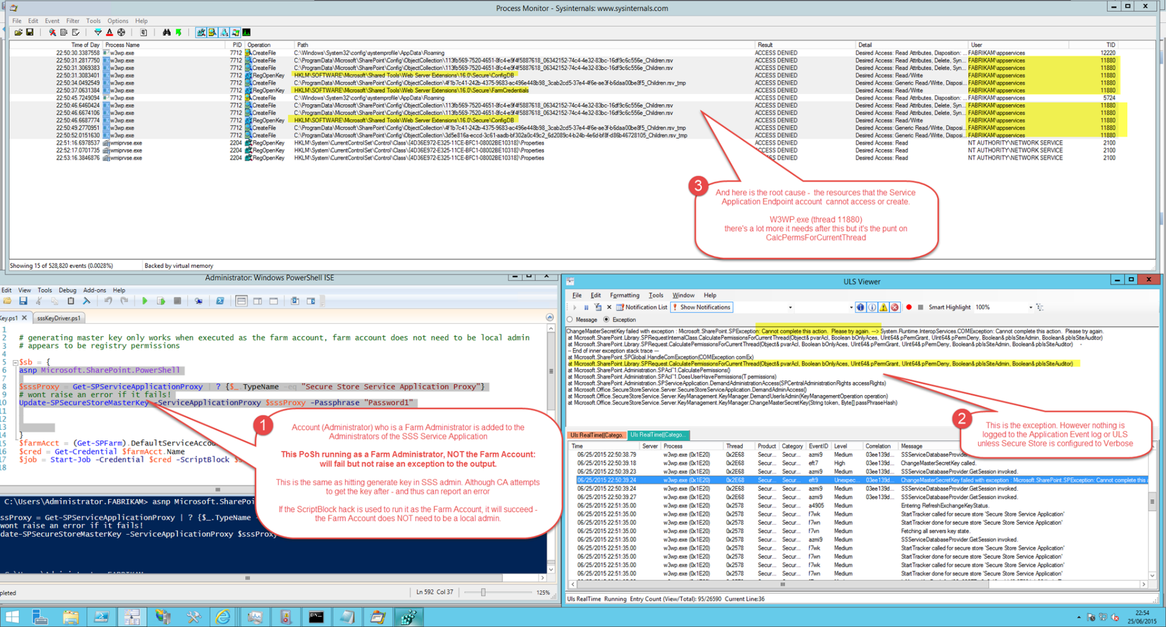
Examples
Update-SPSecureStoreMasterKey

Slide 23
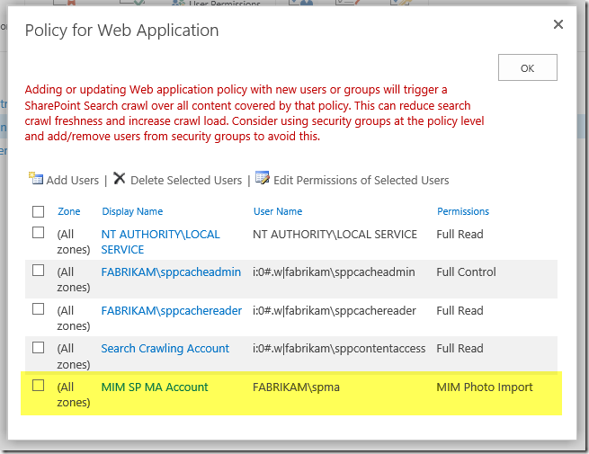
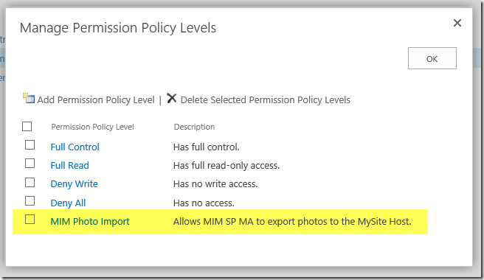
Examples
Update-SPProfilePhotoStore
requires specific Web App Policy to avoid need to use the Farm Account:

Slide 24
Management APIs mean…
Legacy Management APIs (Server Side OM)
And indeed some of the “logic” in SQL Stored procedures
Restrict what we can do and add additional complexity to manage
Order of provisioning
will change steps required in many cases
Significantly impacts permissions and inheritance
The missing playbook
the definition of what must be done in a given situation
In the past, sometimes also known as documentation ☺
http://www.harbar.net/archive/2016/03/21/The-Playbook-Imperative-and-Changing-the-Distributed-Cache-Service-Identity.aspx

Slide 25
Playbook Example
The Distributed Cache service account change…
must be performed using Windows PowerShell
must be performed on a server which runs Distributed Cache
must take place on a server with the Distributed Cache service running
For new SharePoint 2013 farms, the service account should be changed after deploying the first Distributed Cache server, and before deploying the additional Distributed Cache servers
must take place when only a single server is in the Cache Cluster
will result in data loss as all cache hosts must be removed
requires that any cache size configuration be re-applied
For new SharePoint 2016 farms, the service account should be changed after farm creation, and before deploying any Distributed Cache servers

Slide 26
Playbook Example
Show PowerShell module….

Slide 27
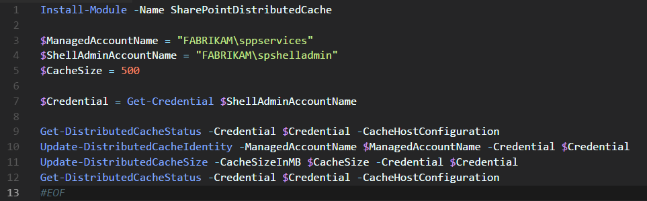
Playbook Example
https://github.com/harbars/SharePointDistributedCache

Slide 28

Office 365 Slowly getting better... But…
#SPSBE
SharePoint Saturday Belgium 2019

Slide 29
Office 365 Considerations
SPO/Office 365 “pattern” – set credentials, connect, perform action, commit
Requires consideration of caching, conflicts and inter-service dependencies
Other related technologies which assist – JSON, ARM etc
Will change the approach to toolbox

Slide 30
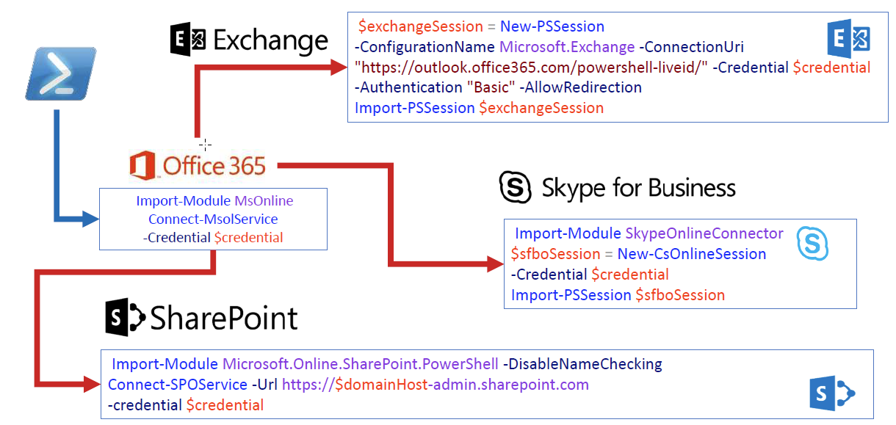
Consistency!!

Slide 31
Essential Workpad Modules for Office 365
Sign-in assistant (needed for MSOL and AzureAD Modules)
Microsoft Online (1.1.183.17)
AzureAD (2.0.2.16)
AzureADPreview (2.0.2.27)
SharePoint Online (16.0.9021.1200)
Microsoft Teams Management Preview (0.9.6) ​
Microsoft Teams Management (1.0)
Skype for Business
Exchange Online
Flow and PowerApps (1.0.7 & 2.0.4)
Flow and PowerApps management
SharePoint PnP PowerShell (3.10.1906.0)
Credential Manager (2.0)

Slide 32

Reusable Tooling
#SPSBE
SharePoint Saturday Belgium 2019

Slide 33
Desired State Configuration
The preferred model for PowerShell automation across the stack
The “make it so” engine
Ensure initial deployment and operational state
SharePoint DSC Resources are a quality implementation, but…
focus on initial deployment
Many elements of SharePoint do not allow the full DSC implementation
Enforces a deployment approach
Additional infrastructure requirements
Most issues are not the resources but rather the back end management APIs
https://github.com/PowerShell/SharePointDsc
Same holds true for ReverseDSC etc

Slide 34
SharePoint / Office 365 PnP PowerShell CmdLets
https://github.com/SharePoint/PnP-PowerShell
Library of PowerShell Cmdlets for provisioning and artefact management
Leverages CSOM
On Premises and Office 365
https://channel9.msdn.com/blogs/OfficeDevPnP/Introduction-to-PnP-PowerShell-Cmdlets

Slide 35
“Workpads”
Many customers invest in building a “workpad”
Working set of common routines and utilities which avoid risks of adhoc scripting
Which combine together the variety of approaches discussed

Slide 36
Broken legacy management APIs
Workpad (time permitting)
Demo
Github.com/harbars/spat
Notes:
Vesa

Slide 37
Other Tooling Considerations
Shell vs ISE vs Visual Studio Code
Scheduling, Logging, Reporting
Third party tools – everything from Ultra Edit to Quest
Working across authoring environments to production environments (“DTAP” – or even worse, “agile” ☺)

Slide 38

Wrap Up
#SPSBE
SharePoint Saturday Belgium 2019

Slide 39
Summary
SharePoint’s management APIs and legacy PowerShell implementation prevents a “step change” in automation solutions
Become a tool maker rather than a “tool”
Remember the core principal of PowerShell – compositional management
Invest in building “toolkits” for common administration tasks
Understand the “quirks” of SharePoint, Office 365 and Azure

Slide 40
Summary
Stay current with PowerShell platform capabilities
Past examples include remoting, classes and of course DSC
There will be more especially related to large scale management scenarios and X platform
Feedback to Microsoft on what needs fixed
Whilst legacy management APIs are unlikely to be fully addressed…
SP On Premises team are invested in bridging the gaps in this area…
…but it needs continual pressure and justification
Much more traction in the O365 world
however significant gaps mandate tooling from elsewhere
e.g. PnP PowerShell,

Slide 41
Thanks for attending!
#SPSBE
SharePoint Saturday Belgium 2019

Slide 42


http://spsbe.be
#SPSBE
Please rate this session!

Slide 43

#SPSBE
SharePoint Saturday Belgium 2019

